Slide 1
Basecamp Session 1
Starknet Foundation
November 2023
starknet

Slide 2

Session Topics
1) Why Cairo?
2) Why Starknet?
3) Architecture
10 mins break
4) Transactions
5) Account Abstraction

Slide 3
Why Cairo?

Slide 4




The Space Exploration Problem
How to save fuel?
Best launch window
Best trajectory
Engineers create algorithm in Rust

Slide 5




Cooperating with a Rival
Execution needs supercomputer
Only rival country has one

Slide 6

To Trust or not to Trust?
Your Country
Rival Country
execute
How do you know if...?
Supercomputer malfunction
Rival spy agency sabotage
result
YOU CAN'T

Slide 7



Trustless Cooperation
Your Country
Rival Country
execute
If the execution is intentionally or unintentionally modified, the proof will be invalid
result
+
proof
A regular computer is able to keep a supercomputer honest

Slide 8

Cairo’s Features
Creates provable programs
Runs on top of CairoVM
Syntax inspired by Rust
Similar ownership model
Strongly typed
Can be used outside of Starknet
No need to know ZK!

Slide 9
struct Rectangle {
height: u64,
width: u64,
}
Custom data types
Scalar types
trait ShapeGeometry {
fn boundary(self: Rectangle) -> u64;
fn area(self: Rectangle) -> u64;
}
Functionality blueprint
Method signature
impl RectangleGeometry of ShapeGeometry {
fn boundary(self: Rectangle) -> u64 {
2 * (self.height + self.width)
}
fn area(self: Rectangle) -> u64 {
self.height * self.width
}
}
Implementations have names
Method implementation

Slide 10
#[starknet::interface]
trait ISimpleStorage<TContractState> {
fn set(ref self: TContractState, x: u128);
fn get(self: @TContractState) -> u128;
}
Contract’s interface
Reference => Modifies state
Snapshot => Read-only
#[starknet::contract]
mod SimpleStorage {
}
Metaprogramming
#[storage]
struct Storage {
stored_data: u128
}
Smart contract state
#[abi(embed_v0)]
impl SimpleStorage of super::ISimpleStorage<ContractState> {
fn set(ref self: ContractState, x: u128) {
self.stored_data.write(x);
}
fn get(self: @ContractState) -> u128 {
self.stored_data.read()
}
}
Public methods
Interface implementation
Writes to storage
Reads from storage

Slide 11

Summary
Why Cairo?
Creates provable programs
Proof of computational integrity
Verification without re-execution
Powerful & flexible language
Prevents cheating and malfunction
Keeps a supercomputer honest

Slide 12
Why Starknet?

Slide 13
The L1 Scaling Problem
Block Producer
the new state is 42
Validators

Slide 14
Execute once, verify everywhere
Starknet
the new state is 42, here's the proof!
Validators

Slide 15
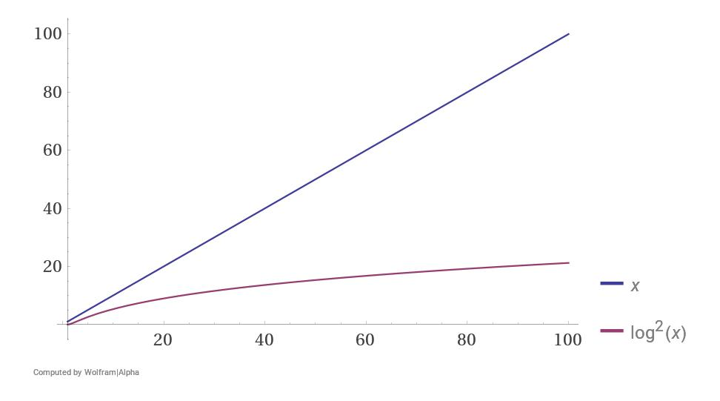
Execution vs Verification
n
log²(n)
Sequencer
Validator
tx computation
verification
Validator
verification
Validator
verification
* Improved with proof recursion

Slide 16
Validity Proof
Computation
Compression
Zip
File Size

Slide 17
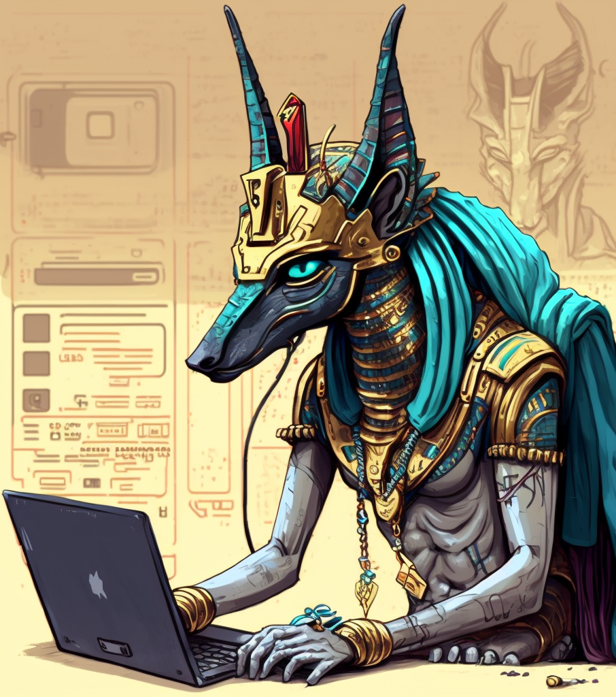
Validity Proofs
A use case of Zero Knowledge Proofs
Used for compression, not privacy
If output is result of program + inputs
Output can be verified without inputs
Validity proof => Validity rollup
Based on STARKs, not SNARKs
Efficient proving and verification

Slide 18
STARK vs SNARK
STARK
SNARK
Verification
log²(n)
constant
Proof Size
~400 KB
288 bytes
Proving Time
1x
10x
Trusted Setup
No
Yes
Quantum Secure
Yes
No

Slide 19

Why CairoVM and not EVM?
Compatibility
Performance
ZK-EVMs
CairoVM

Slide 20
Vitalik's zk-EVM Classification
EVM Changes
Compatibility*
Performance**
Projects
Type I
Nothing
Full
Very Slow
-
Type 2
Storage data structure
High
Slow
-
Type 3
Storage, hashes, precompiles
Partial
Fast
Kakarot, zkSync, Scroll, Polygon zkEVM
Starknet,
Polygon Miden
Type 4
Completely different VM
None
Very Fast
*how feasible it is to execute an Ethereum smart contract without any change
**how much time and resources does it take to create a validity proof

Slide 21

L1 Finality
fastest
Ethereum
(~6 mins)
Starknet
(~10 hours)
Optimistic Rollups
(~1 week)
slowest

Slide 22
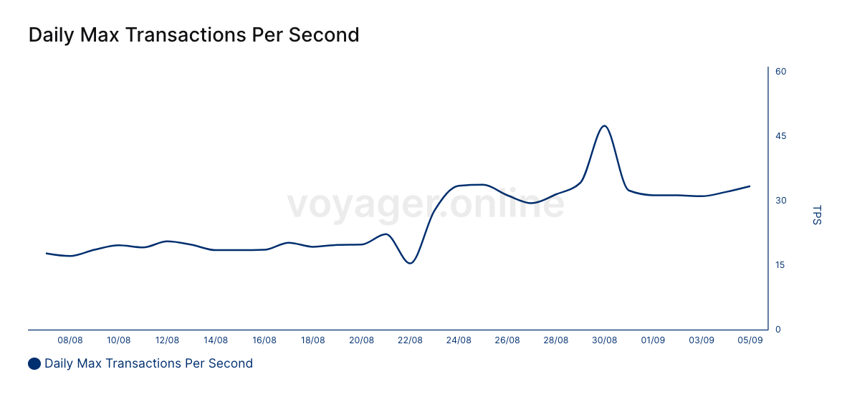
Mainnet Performance
Stats from Voyager block explorer
47.29 TPS with multicall!

Slide 23

Summary
Why Starknet?
Optimized for ZK tech
↑ computing power ↓ gas fees
Secured by STARKs + Ethereum
Powerful programming language
Battled tested tech stack (2y | $1T)
Withdraw assets to L1 in ~10h
No trusted setup

Slide 24
Architecture

Slide 25
Cairo
Cairo
Smart Contract
Provable programming language
Syntax similar to Rust
Compiles to Sierra (Safe Intermediate Representation)
Sequencer compiles Sierra to “Safe CASM” (Cairo Assembly)
Failed txs are included in blocks
Sequencer ALWAYS compensated
No more DoS vector as in Cairo0
compiles
Sierra
compiles
Safe CASM
generates
Validity Proof

Slide 26
Back to our story…
Your Country
Rival Country
execute
result
+
proof

Slide 27
The Internal Modules
Your Country
Rival Country
Laptop
Supercomputer
Cairo Program
send
Sierra
compile
compile
Sierra
CASM
run
result
CairoVM
trace
Verifier
Prover
validity proof

Slide 28
Starknet Modules
Starknet
You
Sequencer
declare
Sierra
Laptop
Cairo Program
compile
compile
CASM
Sierra
run
result
CairoVM
trace
Ethereum
SHARP
Verifier
Prover
validity proof

Slide 29


The Liveness Problem
State N
txs
State N+1
txs
What’s the current state of Starknet?
State N
Sequencer

Slide 30
Data Availability (DA)
Starknet
Sequencer
state diff
Blockchain Writer
L2 Block
exec txs
CairoVM
Ethereum
SN Core
trace
SHARP
Verifier
Prover
validity proof

Slide 31
Recreating L2 state from L1
G
B1
B2
B3
B4
B5
Empty
State A
State B
state diff 1
(sent to L1)
state diff 2
(sent to L1)
Empty + state diff 1 + state diff 2 = State B
L1 Indexer

Slide 32



State Difference (DA)
1 ETH
1 ETH
1 ETH
0.5 ETH
2 ETH
1 ETH
Jimmy:
Rose:
Nick:
-1 ETH
+0.5 ETH
+0.5 ETH
No state diff
0.5 ETH
DA is 90% of the cost of an L2 tx
Jimmy:
Rose:
+0.5 ETH
-0.5 ETH

Slide 33
Zooming Out
get latest block
tx
execution trace
Sequencer
(Starknet OS)
Prover
(SHARP)
Full Node
tx
tx
state diff
validity
proof
Ethereum
Starknet Core
Verifier
sync from L1

Slide 34

Starknet Components
Sequencer: Validates, executes and bundle txs into blocks
SHARP: Creates validity proofs for Starknet and StarkEx
Verifier: L1 smart contract that verifies validity proofs from SHARP
Starknet Core: L1 smart contract that store changes to L2 global state (DA)
Full Node: Provide data to L2 dapps

Slide 35

Summary
Architecture
Cairo compiles to Sierra
Sierra allows the creation of safe CASM
Starknet’s DA mode is “Rollup”
State diffs are sent to L1 for liveness
An L1 indexer can recreate L2 state
Starknet nodes:
L2: Sequencer, Prover, Full Nodes
L1: Verifier, Starknet Core

Slide 36
Transactions

Slide 37
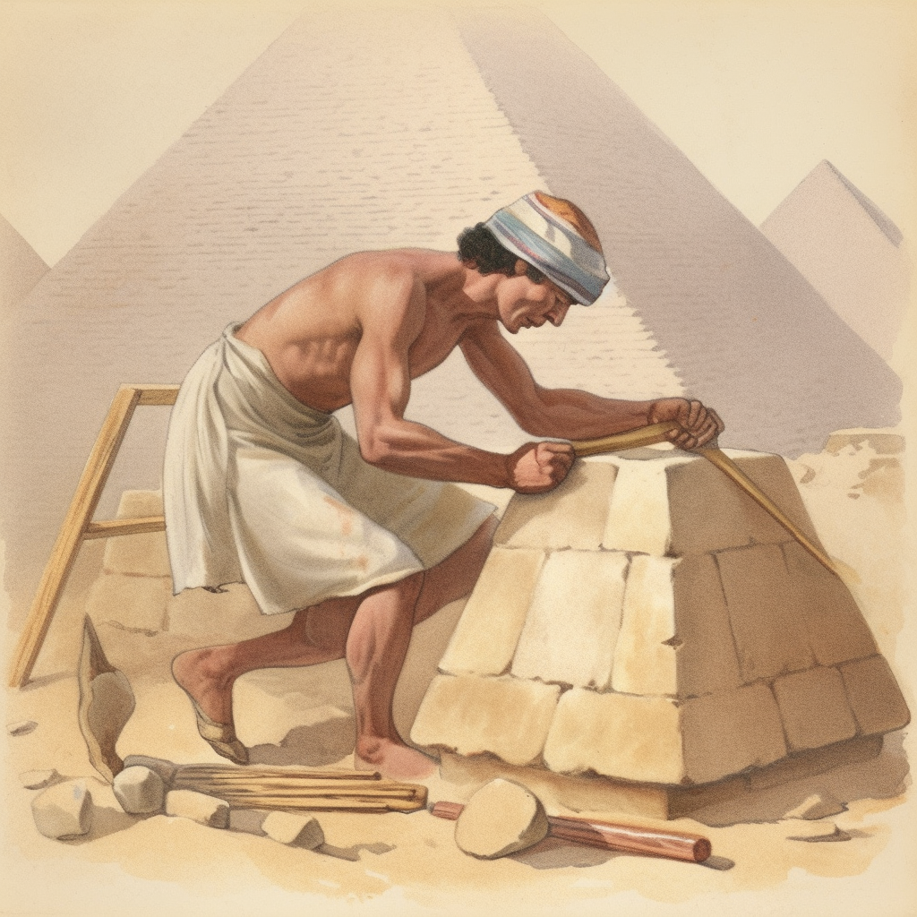
Transaction Types
No deploy transaction?
deploy_account
Deploys an account contract
declare
Registers the Sierra code of a SC
invoke
Executes “write” functions
Modifies the global state
Requires paying gas fees
Calling a read-only functions is not a transaction as it doesn’t modify the global state (no gas fees)

Slide 38
Remember this Diagram?
Starknet
You
Sequencer
declare
Sierra
Laptop
Cairo Program
compile
Oversimplified
compile
CASM
Sierra
run
result
CairoVM
trace
Ethereum
SHARP
Verifier
Prover
validity proof

Slide 39

The “declare” tx
Starknet
Sequencer
TX STATUS
declare tx
Mempool
You
Laptop
compile
RECEIVED
Cairo Program
CASM
add
SUCCEEDED
or
REJECTED
compile
Block
Sierra
class hash
Writer
compiled class hash
Ethereum
ACCEPTED_ON_L2
SN Core
trace
SHARP
Verifier
Prover
validity proof
ACCEPTED_ON_L1

Slide 40
The “invoke” tx
Starknet
Sequencer
TX STATUS
You
Mempool
Laptop
execute
RECEIVED
Wallet
invoke tx
CairoVM
add
SUCCEEDED
or
REJECTED
Block
state diff
Writer
Ethereum
ACCEPTED_ON_L2
SN Core
trace
SHARP
Verifier
Prover
validity proof
ACCEPTED_ON_L1

Slide 41
Declaring vs Deploying
Declaring registers Sierra code on L2
Declared code is aka “contract class”
Contract classes don’t have internal storage
Used as libraries and “blueprints”
From blueprint an instance can be deployed
Contract istances have internal storage
Every instance has a different address
Contract Class
(Sierra)
class hash
Contract Instance
(CASM)
address A
constructor called
Contract Instance
(CASM)
address B
Contract Instance
(CASM)
address C

Slide 42

Universal Deployer
Smart contract that deploys other smart contracts
Only one selector: deployContract
Selector must be invoked with:
Blueprint’s class hash
Constructor arguments
Internally uses the deploy syscall
Created by OZ as a public good
Written in Cairo0

Slide 43
Smart Contract Classes vs Instances
Starknet
Smart Contract Class
Smart Contract Class
declare
tx
declare
tx
constructor
arguments
Universal Deployer
Smart Contract Instance
Smart Contract
invoke tx
library call
deploy
invoke/call tx

Slide 44
Summary
Transactions
Tx types:
deploy_account
declare
invoke
Tx lifecycle:
Received
Succeeded/Rejected
Accepted on L2
Accepted on L1
Declare vs Deploy => Class vs Instance
Deploy => Invoke Universal Deployer

Slide 45
Account Abstraction

Slide 46

AA on Starknet
Every single wallet implements AA
Decoupling of Signer and Account
Multiple operations in a single tx
Custom logic to verify tx signature
Different elliptic curves supported
Stark-friendly EC, secp256k1 (Ethereum), secp256r1 (Standard)

Slide 47

Bundling User Operations
Sometimes an action requires multiple steps (user operations)
x
block
block
block 1
block 2
tx
step 1
step 1
step 1
step 1
other
tx
step 2
step 2
other
other
step 2
other
step 2
other
other
step 1
step 1
other
step 2
step 2
other
other

Slide 48
Multicall on Starknet
Multiple steps (user operations) as a single transaction
x
x
x
bundle
block
block
block 1
block 2
step 1
step 1
step 1
step 1
other
step 2
step 2
other
other
step 2
other
step 2
other
other
x
x
x
step 1
step 1
other
step 2
step 2
other
other

Slide 49


Smart Wallets
Aka Account Abstraction (protocol level)
trait IAccount<T> {
fn __execute__(
ref self: T,
calls: Array<Call>
) -> Array<Span<felt252>>;
fn __validate__(
self: @T,
calls: Array<Call>
) -> felt252;
...
}
Starknet
invoke tx
User Account Contract
Target Contract
signer
(wallet)

Slide 50
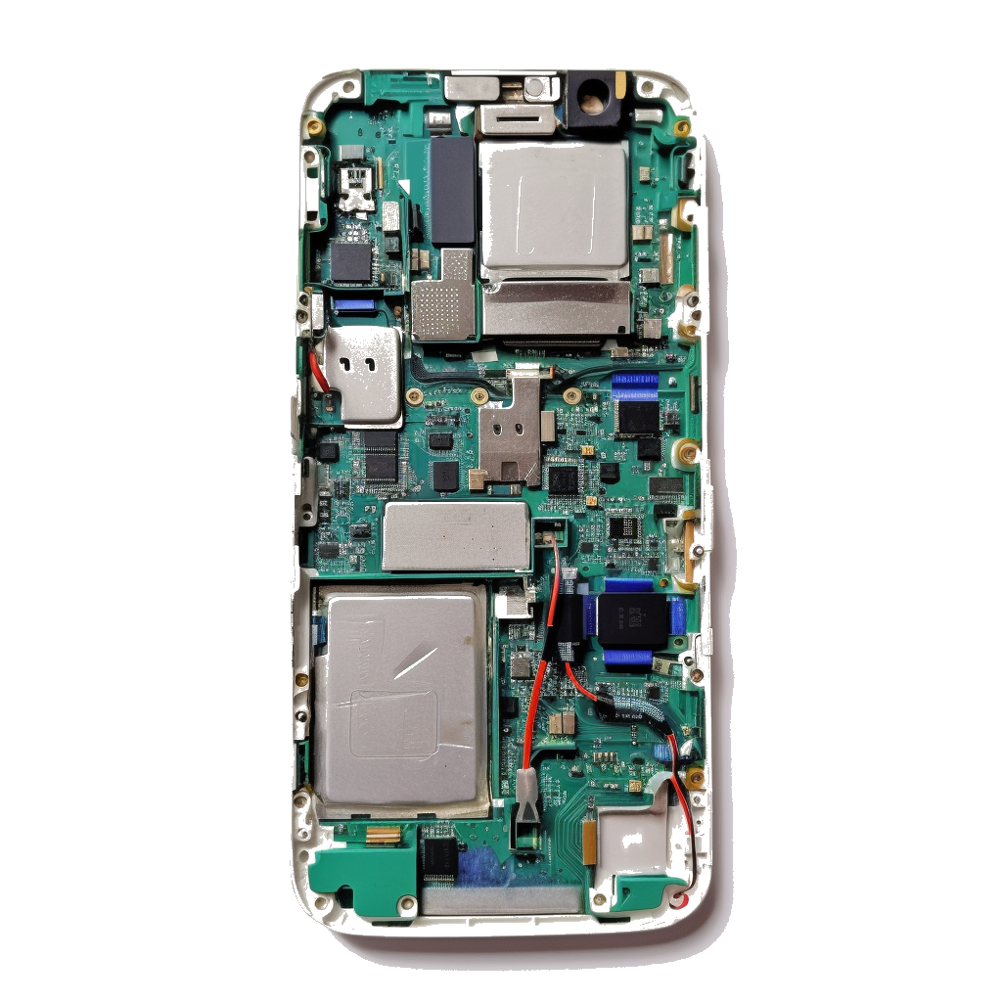




AA + Secure Enclave
Turn your smartphone into a hardware wallet
Applies also for Laptops & PCs
.Shared.
.System.
Secure Enclave
Shared Processor
Shared Memory
Operating System
Applications
Titan M
Knox
TrustZone
.Secure.
.Enclave.
Random Number Generator
Crypto keys management
Hardware signer (secp256r1)
Keychain, TouchID and FaceID
Dedicated Processor
Dedicated Memory

Slide 51

Summary
Account Abstraction
Signature verification and tx execution logic defined as a smart contract
First class citizen on Starknet
Allows for bundling of user operations
To deploy it, the address needs to be calculated off-chain first
"Counterfactual deployment"
Turns smartphones and laptops into hardware wallets

Slide 52
The End. Questions?

